Slide 1


Building a Cat vs. Dog Classifier Using Keras and TensorFlow
Jonathan

Slide 2
Catalogue
1.
Project Overview
2.
Setting Up the Environment
3.
Data Preparation and Augmentation
4.
Building the Neural Network Model
5.
Training and Evaluating the Model
6.
Making Predictions and Model Evaluation

Slide 3
01
Project Overview

Slide 4

Introduction to the Classifier
Understanding the Project's Goal
The Importance of Transfer Learning
The Role of TensorFlow and Keras
This section will introduce the audience to the project's objective, which is to build a deep learning model capable of classifying images of cats and dogs. The goal is to provide a brief overview of the motivation behind the project and its potential applications in the field of computer vision.
Here, we will discuss the concept of transfer learning and its significance in our project. By leveraging a pre- trained model like ResNet50, we can significantly reduce the training time and improve the model's performance, especially when working with limited data.
This part will highlight the importance of TensorFlow and Keras in the development of our deep learning model. We will explain how these frameworks provide the necessary tools and APIs to build, train, and deploy our cat vs. dog classifier efficiently.

Slide 5
02
Setting Up the Environment

Slide 6

Importing Libraries and Modules
Necessity of Libraries and Modules
Utilizing Pre-trained Models
Preparing for Model Development
In this section, we will detail the importance of each library and module imported for the project. We will explain the role of general libraries like 'os' and 'matplotlib', as well as TensorFlow and Keras- specific modules that are crucial for building and training our model.
This part will focus on the benefits of using pre- trained models in transfer learning. We will discuss how models like ResNet50, which are pre- trained on large datasets like ImageNet, can be fine- tuned for our specific classification task.
The final subtopic under this main topic will cover the initial setup required for model development. This includes setting up the environment, understanding the functionality of each module, and preparing any necessary data preprocessing steps.

Slide 7
03
Data Preparation and Augmentation

Slide 8
Part 01
Part 02
Part 03
Structuring the Data for Model Training
Enhancing the Dataset with Data Augmentation
Optimizing Data Loading for Efficient Training
This section will explain how the data is organized into 'dogs' and 'cats' folders within the training directory. This structure simplifies the data loading process and allows the model to easily infer class labels from directory names.
Data augmentation is a critical technique for improving the model's robustness. In this section, we will discuss how random transformations like rotation, flipping, and zooming are applied to the images to create a more diverse training dataset.
Efficient data loading is essential for training deep learning models. This part will cover techniques like caching and prefetching, which ensure that data is loaded quickly and efficiently, keeping the GPU utilization high and reducing idle time.

Slide 9
04
Building the Neural Network Model

Slide 10
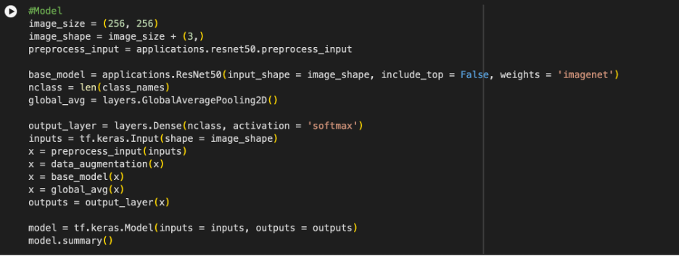


Slide 11
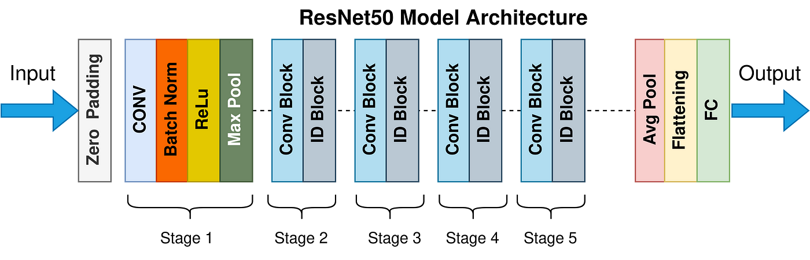
Constructing the Model Architecture
Utilizing ResNet50 for Feature Extraction
The ResNet50 model, pre- trained on the ImageNet dataset, serves as the backbone of our classifier. This section will explain how we adapt this powerful model to our specific task of distinguishing between cats and dogs by excluding the top layers and adding our own classification layers.
Implementing Data Preprocessing
Adding Custom Layers for Classification
To ensure compatibility with the pre- trained ResNet50 model, specific preprocessing steps are required. This part will cover how images are resized and normalized to match the input format expected by the model.
After the base ResNet50 model, we add custom layers to adapt the model to our binary classification task. This section will detail the addition of a global average pooling layer and a dense layer with softmax activation to output the class probabilities.

Slide 12
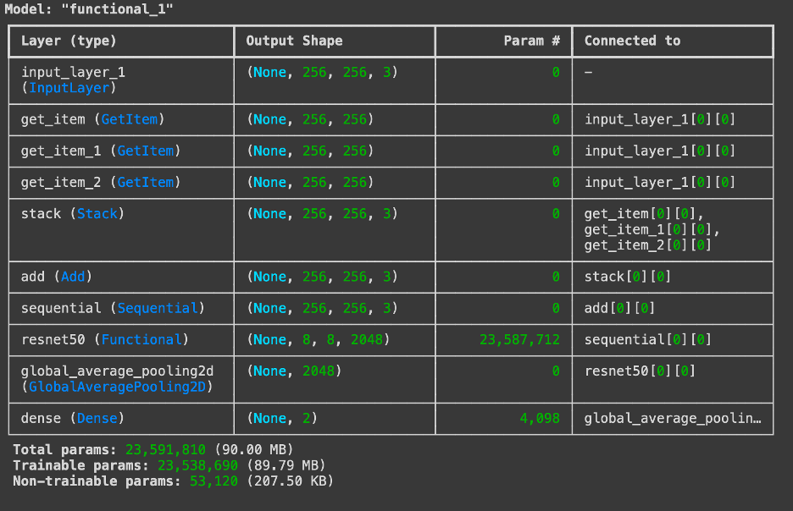

Slide 13
Building the Model
Defines the size of each input image as 256x256 pixels. A standard size across all images is required, and 256x256 is large enough to retain meaningful image details for classification without being overly computationally intensive. Adds the color channel dimension, setting image_shape to (256, 256, 3). The 3 represents the RGB channels, specifying that the input images are in color. This is essential for the model to understand the input format. Sets up a preprocessing function specific to ResNet50, which normalizes input images as expected by this model. ResNet50, trained on ImageNet, expects images in a specific format (pixel values normalized to a range suitable for ResNet). Using preprocess_input ensures the images are standardized for optimal performance. Loads the pre-trained ResNet50 model with: •input_shape=image_shape: Accepts images of shape (256, 256, 3). •include_top=False: Excludes the original fully connected layers that classify ImageNet’s 1,000 classes. •weights='imagenet': Initializes with weights learned from the ImageNet dataset. Using pre-trained weights lets us leverage this knowledge, reducing the need for a large dataset or long training time. By excluding the top layers, we can add our own output layers tailored for the binary classification task (cats vs. dogs). Sets nclass to the number of classes (2 in this case, for cats and dogs). Defines the number of neurons in the output layer, ensuring it matches the number of categories we want to classify.

Slide 14
Building the Model
Adds a global average pooling layer. Dimensionality Reduction: Global average pooling reduces each feature map to a single value by averaging, resulting in a smaller, more generalized feature vector. Less Overfitting: Compared to fully connected layers, this pooling approach has fewer parameters, which reduces the risk of overfitting. Interpretability: Global average pooling tends to produce features that are less sensitive to small image transformations. Adds a dense layer with nclass neurons (2, one for each class) and softmax activation to output class probabilities. This layer interprets the feature vector output by ResNet50, assigning probabilities to each class (cat or dog). Softmax is ensure the output values sum to 1, making them interpretable as probabilities. Defines the input layer for the model, specifying the expected shape (256, 256, 3). Sets up the model’s starting point, clearly defining the input size and structure. Applies the ResNet-specific preprocessing to the input images, normalizing pixel values. Standardizing the images helps ensure they match the input format ResNet50 was trained on, improving the transfer learning effectiveness. Applies data augmentation (random rotations, flips, zooms, etc.) to the images. Augmentation increases the variety of images seen during training, making the model more robust and less prone to overfitting. Passes the preprocessed, augmented data through the ResNet50 base model. This

Slide 15
05
Training and Evaluating the Model

Slide 16
Compiling and Training the Model
Selecting the Optimizer and Learning Rate Schedule
The Adam optimizer with a cosine decay learning rate schedule is chosen for training our model. This section will explain why this combination is effective for handling the optimization landscape of our neural network.
Configuring the Model for Training
Before training, the model needs to be compiled with the chosen optimizer, loss function, and metrics to track. This part will cover how the model is configured for training, including the selection of the loss function and evaluation metrics.
Monitoring Model Performance
During training, it's crucial to monitor the model's performance on both the training and validation datasets. This section will discuss how key metrics such as accuracy and loss are tracked to evaluate the model's learning and generalization to new data.

Slide 17
Adam Optimizer: The Adam (Adaptive Moment Estimation) optimizer is a commonly used optimization algorithm in deep learning. It adapts the learning rate for each parameter during training, which typically results in faster convergence and better performance. Cosine Decay: This applies a learning rate schedule that decreases the learning rate following a cosine curve over the course of training. Initial Learning Rate (0.001): The initial learning rate is set to 0.001, which is a common starting value for Adam. Decay Steps (500): The learning rate decreases over 500 steps (or epochs, depending on how you define it). The cosine decay reduces the learning rate more gently compared to traditional step decay, helping the model train more smoothly and potentially achieve better performance. Why Use Cosine Decay? As training progresses, lowering the learning rate allows the model to fine-tune more precisely without overshooting. Cosine decay smooths this process by reducing the learning rate gradually. We’re starting with a learning rate of 0.001, which gradually decreases following a “cosine” curve over 500 steps. A gradually decreasing learning rate helps the model “fine-tune” itself as training progresses. loss = losses.SparseCategoricalCrossentropy() defines the loss function, which measures how well the model’s predictions match the actual labels during training. classification tasks with multiple classes (cat and dog), It’s appropriate when the labels are provided as integers (e.g., 0 for “cat” and 1 for “dog”) rather than one-hot encoded vectors. In regular CategoricalCrossentropy, labels are one-hot encoded vectors. In “sparse” format, the labels are single integers, and TensorFlow automatically handles the conversion internally.

Slide 18
Model Compile compiles the model, specifying the optimizer, loss function, and performance metrics to track during training. Compiling the model tells TensorFlow which optimization algorithm (optimizer), loss function, and evaluation metrics to use during training. During training and validation, the model will display the accuracy to provide feedback on how well it is performing. history = model.fit(pf_train, validation_data=pf_val, epochs=5) trains the model using the training dataset and validates it using the validation dataset for a specified number of epochs. pf_train: This is the preprocessed and prefetched training dataset. validation_data=pf_val: The model will evaluate its performance on the validation set (pf_val) after each epoch to track how well it generalizes to unseen data. epochs=numbers: The model will go through the entire training dataset how many times during training.
Final Training Accuracy: 83.97% Final Validation Accuracy: 83.91%

Slide 19
06
Making Predictions and Model Evaluation

Slide 20
Evaluating Model Predictions
Analyzing Model Accuracy
Identifying and Addressing Model Errors
Preparing the Model for Real-world Deployment
After training, the model's accuracy on both the training and validation sets is evaluated. This section will analyze the final training and validation accuracies, providing insights into the model's effectiveness and potential overfitting or underfitting issues.
By examining the cases where the model makes incorrect predictions, we can gain insights into its weaknesses. This part will discuss how this analysis can help in identifying areas for improvement, such as collecting more diverse training data or adjusting the model architecture.
Once the model has been trained and evaluated, the next step is to prepare it for real- world deployment. This section will cover additional testing, optimization for inference speed, and integration into a user interface or application, ensuring that the model performs well in a live environment. Please note that the image placeholders should be replaced with actual URLs or file paths to the images you wish to include in your presentation. Since I cannot access the actual images from your file, you will need to insert the images manually into your slides.

Slide 21
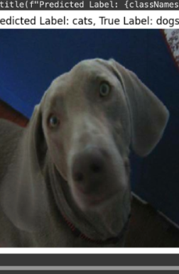
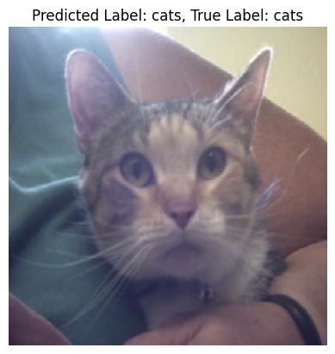
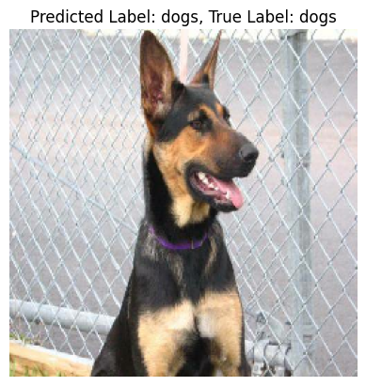

Slide 22
Thank You
Jonathan Guan

